Slide 1
Double Checked Locking Pattern
Presented by Guy David

Slide 2

Outline
Introduction.
The Singleton Pattern.
Double Checked Locking.
The Bug Implementation.
A Scenario of the Bug.
Experiments.
Conclusions.

Slide 3

Introduction
Double-Checked Locking is used to reserve system resources like avoiding unnecessary synchronization.
Double-Checked Locking was developed to deal cleverly with the singleton pattern.
Unfortunately it doesn’t work…

Slide 4
The Singleton Pattern (1)
Sometimes it's appropriate to have exactly one instance of a class.
Singletons are the design pattern when you want only one instance of a class created.
Typically, singletons are accessed by disparate objects throughout a software system, and therefore require a global point of access.

Slide 5

The Singleton Pattern (2)
class Singleton
{
private static Singleton instance;
. . .
public static Singleton getInstance()
{
if (instance == null)
instance = new Singleton();
return instance;
}
}
If you never use the singleton object, it never gets created, saving RAM.

Slide 6
The Singleton Pattern (3)
When we use a single threaded application, there is no problem.
The problems begin when used with multiple threads.

Slide 7
class Singleton
{
private static Singleton instance;
. . .
public static Singleton getInstance()
{
if (instance == null)
instance = new Singleton();
return instance;
}
}
Two threads are inside the if block.
Both will instance the Singleton
Context Switch

Slide 8
In order to avoid two threads to allocate two instances of the singleton, we need some kind of synchronization.

Slide 9
Synchronization Options
Use a synchronized method.
  Problem: synchronized methods run much slower - as much as 100 times slower - than ordinary unsynchronized methods.
Put synchronized() after the check condition.

Slide 10
class Singleton
{
private static Singleton instance;
. . .
public static Singleton getInstance()
{
if (instance == null)
synchronized(o) {
instance = new Singleton();
}
return instance;
}
}
Still two threads are inside the if block.
Both will instance the Singleton
Context Switch
Not good enough…

Slide 11
Solution:
Double Checked Locking
class Singleton
{
private static Singleton instance;
. . .
public static Singleton getInstance()
{
if (instance == null)
{
synchronized(Singleton.class) {
if (instance == null)
instance = new Singleton();
}
}
return instance;
}
}

Slide 12
Well… It Still Doesn’t Work!
The pattern is incorrect according to the Java memory model, and it is not guaranteed to work.
Instead of failing consistently, it will fail sporadically.
The reasons for its failure are not obvious and involve intimate details of the Java memory model.
These facts make a code failure due to double-checked locking very difficult to track down.

Slide 13
The Bug Implementation
The application simulates a process of travel agents booking flight tickets on a plane.
The number of travel agents and tickets can be controlled by the user.
Each agent works in a different thread and they all trying to book the tickets simultaneously.
Every ticket can be bought only once – and this represents the singleton.

Slide 14
A Glance to the Code
public static void main(String[] args){
. . .
// fill seats array
for( int i = 0; i < seats_num; i++)
seats[i] = new Seat();
// fill thread (agents) array
for( int i = 0; i < agents_num; i++)
agents[i] = new TravelAgent(i);
for( int i = 0; i < agents_num; ++i)
agents[i].start();
// wait for threads (agents) to finish
for( int i = 0; i < agents_num; ++i){
try{
agents[i].join();
}
catch(InterruptedException e){
}
}
{
static Seat[] seats; // Global
static TravelAgent[] agents;
static class Seat {
Ticket ticket;
}

Slide 15
static class Ticket { // The Singleton
String status;
int flight;
int airline;
int agent_name;
Ticket(int name){
flight = flight_num;
airline = airline_company_code;
status = new String("Sold");
agent_name =name;
}
}

Slide 16
static class TravelAgent extends Thread {
int name;
TravelAgent( int agent_name){
name = agent_name;
}
public void run(){
for( int i = 0; i < seats_num; i++) {
if (seats[i].ticket==null) {
synchronized(seats[i]){
if (seats[i].ticket==null) {
seats[i].ticket=new Ticket(this.name);
}
}
}
else {
synchronized(seats[i]){
check_ticket_details(i);
}
}
}
}
}
Checks if the initialization was completed, meaning, if the bug happened.

Slide 17
A Scenario of the Bug

Slide 18
static class TravelAgent extends Thread {
int name;
TravelAgent( int agent_name){
name = agent_name;
}
public void run(){
for( int i = 0; i < seats_num; i++) {
if (seats[i].ticket==null) {
synchronized(seats[i]){
if (seats[i].ticket==null) {
seats[i].ticket=new Ticket(this.name);
}
}
}
else {
synchronized(seats[i]){
check_ticket_details(i);
}
}
}
}
}
Assume 2 threads are trying to create a ticket:
1. Thread 1 enters the run() method.
2. Thread 1 enters the synchronized block at because instance is null.
3. Thread 1 checks again at if the instance is null (it still is) and enters the if block.
4. Thread 1 proceeds to and makes instance non-null, but before the constructor executes.
5. Thread 1 is preempted by thread 2.
6. Thread 2 checks to see if instance is null. Because it is not, thread 2 goes to the else part at and there uses fully constructed, but partially initialized, object.
7. Thread 2 is preempted by thread 1.
8. Thread 1 completes the initialization of the ticket object by running its constructor.
1
2
2
1
1
1
2

Slide 19
The result of this scenario:
Using an object without fully initializing it.

Slide 20
Experiments

Slide 21
RaceFinder (1)
The goal in running RaceFinder was, trying to make the application reach a scenario similar to the one shown before.
In all tests every concurrency ran 200 times.
Basic test - The first test was running RaceFinder with no noise at all.

Slide 22
RaceFinder (2)
Yield test - insertion of yield noise (inserting calls to yield() in chosen points of the code).
  Loop, yield probability: 30 - 60 - 90.
Barrier test - the barrier noise inputs delays in access to the variables in the application.
  Barrier time – 100.
  Barrier probability – 100.

Slide 23
RaceFinder (3)
White noise - The white noise here comes to create the noise (yield and barrier) in every possible place in the application, and not only when variable accessed.
Variables - The variables I put the noise on, were the singleton variable – seats().Tickets and the array seats. These variables were also with the highest number of accesses.
In all test I have used "noise before event" and "noise after event" options.

Slide 24
Results
The bug was not found.
No noise, from the noises described, in separate or together, could make the application generate the bug.
The following graph represent a test result:

Slide 25
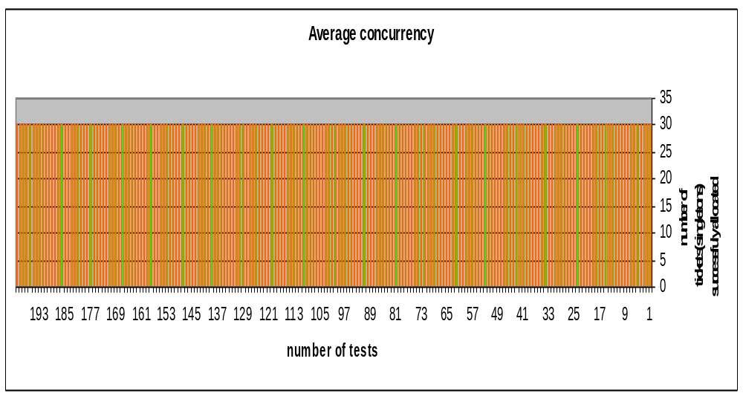

Slide 26
Manual Testing
I have tried to create a scenario of the bug, manually.
According to the scenario was described earlier, I have tried to force a context switch in the tickets, the singleton, constructor.
For that manner I have put a yield() or sleep() function ( one or more ) in the constructor:

Slide 27
static class Ticket { // The Singleton
String status;
int flight;
int airline;
int agent_name;
Ticket(int name){ // Constructor
Thread.yield();
flight = flight_num;
airline = airline_company_code;
status = new String("Sold");
agent_name =name;
}
}

Slide 28
Although I have ran many tests, putting yields in more places, sleeps, waits, trying to track down the scheduling path, different concurrencies…
The bug did NOT happen.

Slide 29
Manual Testing (2)
Initialization of a location x must end before concurrent access to x by multiple threads is possible.
Therefor, the JVM automatically provides synchronization for class initialization to ensure that other threads cannot access x until the class initializer for C terminates.
“The implementation of the Java virtual machine is responsible for taking care of synchronization and recursive initialization by using the following procedure…”(Java Language Specification)

Slide 30
The FindBugs Tool
FindBugs is a Static analysis tool to finds bugs in Java programs.
It looks for instances of "bug patterns", meaning, code instances that are likely to be “buged”.
The Results:
This was the only tool that found the bug.
Screenshots:

Slide 31
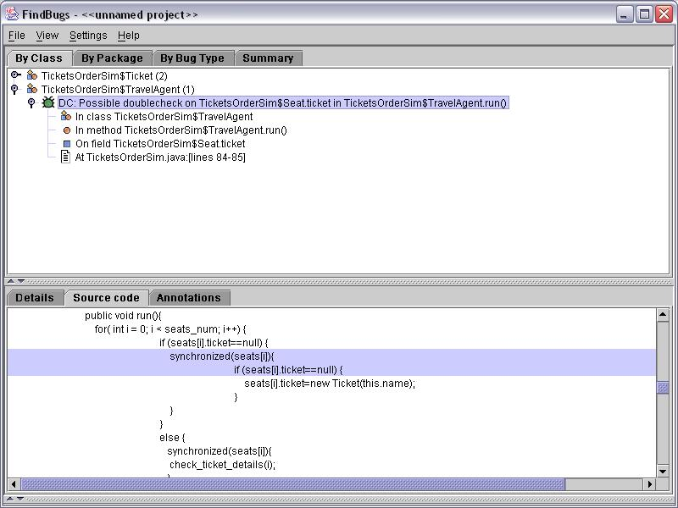

Slide 32
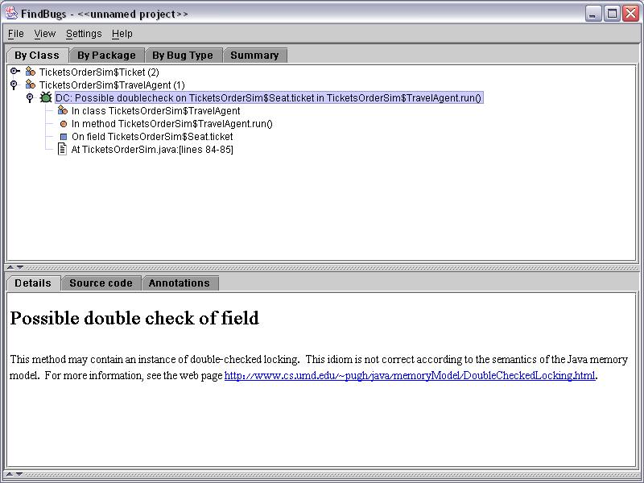

Slide 33
Conclusions
The DCL pattern is incorrect according to the Java memory model, and it is not guaranteed to work.
The DCL pattern is very hard to detect by noise makers.
Despite the above, it is still a BUG, and it is not guaranteed that it will run correctly on any JVM implementation.
We can see the importance of static analysis tools in the process of finding bugs (especially with bugs are very hard to detect by dynamic analysis).

